Slide 1
Cramping CAT 5 :Straight through
Data Communication & Network
Week 04: Practical

Slide 2
Communication or Networking Media
Guided Media/Wired Media:
Twisted Pair
Coaxial Cable
Optical Media
Unguided Media/ Wireless Media
Radio
Microwave
Infrared

Slide 3
Twisted Pair Cables
Two types.
Shielded Twisted Pair Cables (STP)
Unshielded Twisted Pair Cables (UTP)

Slide 4
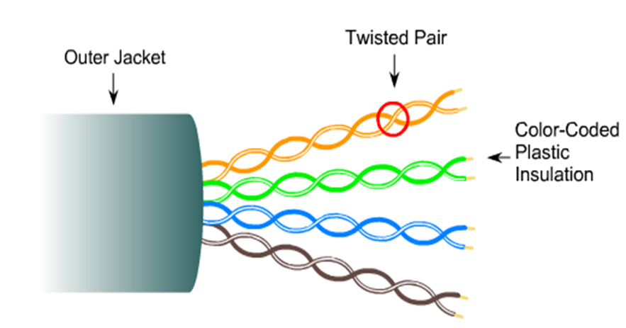

Twisted Pair Cables
Unshielded Twisted pair cables (UTP)
Commonly used UTP are categorized as CAT3,CAT5 & CAT5e
Two types
Straight through
Crossover
Use RJ45 connector for UTP cables

Slide 5

Unshielded Twisted pair cables (UTP)
Connecting Different Devices – straight through cable
Switch and a PC

Slide 6

Straight-through Cable

Slide 7
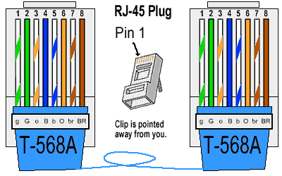
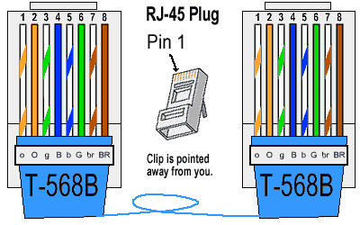
T-568A & T-568B Straight-Through Ethernet Cable
The T-568A standard is supposed to be used in new network installations. Most off-the-shelf Ethernet cables are still of the T-568B standard; however, it makes absolutely no functional difference in which you choose.
Both the T-568A and the T-568B standard Straight-Through cables are used most often as patch cords for your Ethernet connections

Slide 8
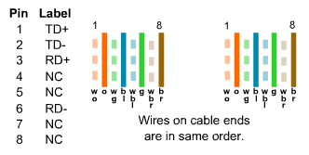
Straight-through Cable

Slide 9
Straight-through Cable

Slide 10
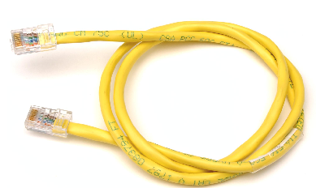
Straight-through Cable

Slide 11
Use straight-through cables for the following connections:
Switch to router
Switch to PC or server
Hub to PC or server

